Slide 1
Lesson 9 - Reading Documentation
Mr Mack 2019

Slide 2
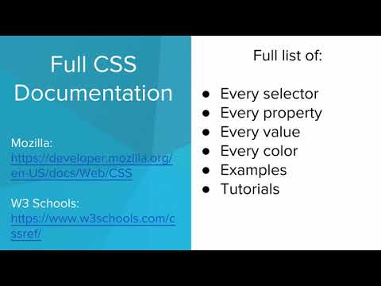
Reading Documentation

Slide 3
Who might need to look something up in HTML/CSS documentation?
A student learning about web development
A web developer using a new feature
A person building a personal website as a hobby
All of the above!

Slide 4
Example: Using Docs: Float
This webpage makes use of the float attribute, found here:
https://www.w3schools.com/Css/css_float.asp

Slide 5
Example: Using Docs: blockquote
This webpage uses the new tag blockquote, which can be found here: https://www.w3schools.com/html/html_quotation_elements.asp

Slide 6
Exercise 4.9.1: Style the Table
You will need to use the DOCS tab for this exercise.
Here is the start of a web colors table. You should add two more colors, chosen either by using the Color Picker in the DOCS or looking at the list of 140 color names provided under the Color Names section of the DOCS.
Then, add a rule for table that personalizes the table’s border. You should change how thick the border is, what the color of the border is, and the style of the border. Use the DOCS to see which attributes you need to set to achieve these goals.
For a full list of CSS properties, see https://www.w3schools.com/cssref/.

Slide 7
Exercise 4.9.2: Electric Company
The Bright! Bright! Electric Company needs you to make a Contact Us page.
Set up the structure
First, create two <div>s. Give the first one the class header, and give the second one the class content.
Put a h1 tag in header that says “Bright! Bright! Electric Company”. Put the following contact information in a paragraph tag in the content div:
Contact Us:
Bright! Bright! Electric Company
(123) 456 - 7890
123 Main St
Kareltown, CA 12345
You may find <br> tags useful.
Set up the styles
Now we need to add the styles.
Style header to have the font color LemonChiffon, the background color black, and a width of 50%.
Style content to have the background color HoneyDew, a font size of 24px, and a width of 70%.
Finally, give the body this background image, repeated three times:
https://codehs.com/images/lightbulb
Check out the DOCS to see how to add a background image and make it repeat.

Slide 8
Exercise 4.9.3: Career Website: Add Pictures
In this exercise, you will add some more content to the homepage of your website.
Add Pictures
Find four images that represent the career to you. Each image should have the alt text defined to explain what the image is about.
Remember to use pictures that you are legally allowed to use (check the copyright! Make sure to attribute the image if that’s necessary).
Add Styles
Once you have the images, add some styling to the images. In style.css, make all images 200px by 200px. Give all images a 5px, solid black border to make them easy to see. Check the DOCS if you’ve forgotten how to set the border!

